Slide 1
How much is Heart of the Ocean worth?
Jay Choi, Yonghyeon Kweon, Logan Lee, Taeheon Park
Notes:
Hi, I am Taeheon,
Jay, Yonghyeon, and Logan.
Our main topic is “How much is Heart of the Ocean worth?
If you don’t know what the Heart of the Ocean is, you are going to know in a minute.
So we are going to talk about Introduction first, data manipulation, regression analysis and the conclusion.
Do you remember who they are and what movie this is? Yes, this film is Titanic and they are Jack and Rose.
The reason that I put this old lady’s picture is because our main topic is what she is holding here.
She is holding the 56 carat blue diamond. It is! the! Heart of the Ocean.
We were trying to look for the most interesting topic using our dataset. Finally, we came up with the Heart of the Ocean in the movie Titanic and wanted to estimate the price of it.
Actually Heart of the Ocean does not exist in real world. But we realized that the Heart of the Ocean in the film was based on the Hope Diamond, which is a real piece of jewelry. So, our main goal is to estimate prices of both diamonds by our model.
I think everyone already knows what kind of data we have. From the left to right, it represents good and bad.

Slide 2
Agenda
Introduction
Data Manipulation
Regression Analysis
Conclusion
Notes:
So we are going to talk about Introduction first, data manipulation, regression analysis and the conclusion.

Slide 3
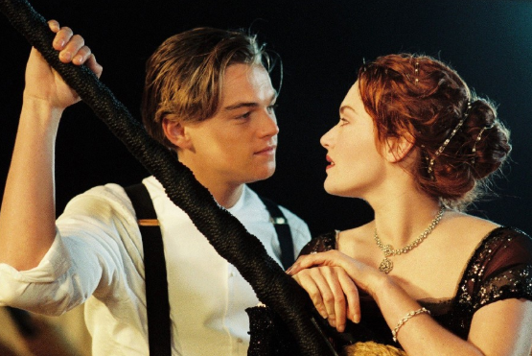
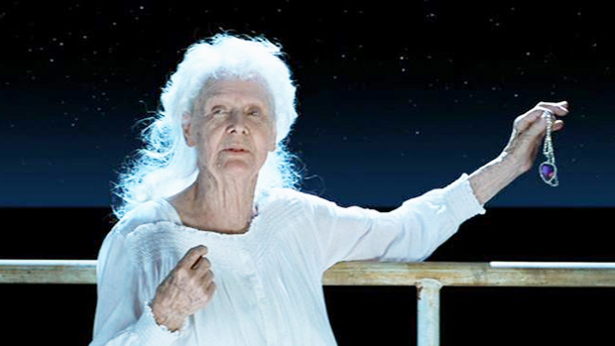
Notes:
Do you remember who they are and what movie this is? Yes, this film is Titanic and they are Jack and Rose.
The reason that I put this old lady’s picture is because our main topic is what she is holding here.
She is holding the 56 carat blue diamond. It is! the! Heart of the Ocean.
We were trying to look for the most interesting topic using our dataset. Finally, we came up with the Heart of the Ocean in the movie Titanic and wanted to estimate the price of it.

Slide 4
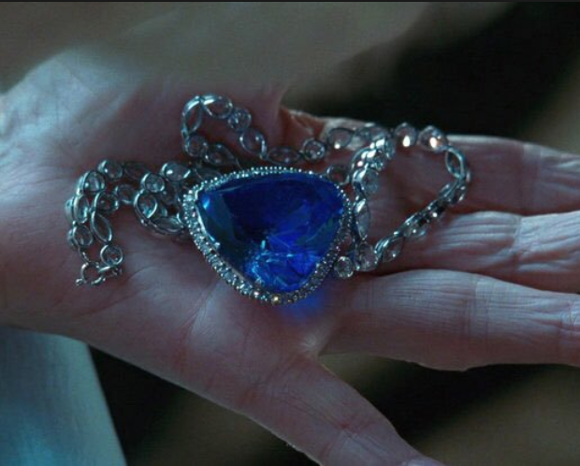
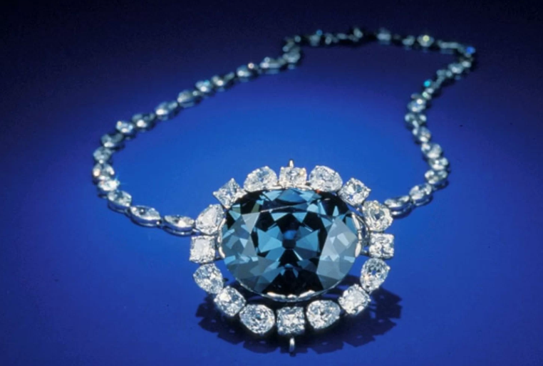
Main Goal
To estimate prices of both diamonds by our model
Heart of the Ocean (fiction)
Hope Diamond (reality)
Notes:
Actually Heart of the Ocean does not exist in real world. But we realized that the Heart of the Ocean in the film was based on the Hope Diamond, which is a real piece of jewelry. So, our main goal is to estimate prices of both diamonds by our model.

Slide 5
Data Description
Carat
Clarity
Color
Cut
20.45 0.23
Flawless | Internally Flawless | Very Very Slightly Included |  | Very Slightly Included |  | Slightly Included |  | Included
Grade | FL | IF | VVS₁ | VVS₂ | VS₁ | VS₂ | SI₁ | SI₂
D | E | F | G | H | I | J
Colorless |  |  | Near Colorless
Astor Ideal | Ideal | Very Good | Good
good
bad
Notes:
I think everyone already knows what kind of data we have. From the left to right, it represents good and bad.

Slide 6
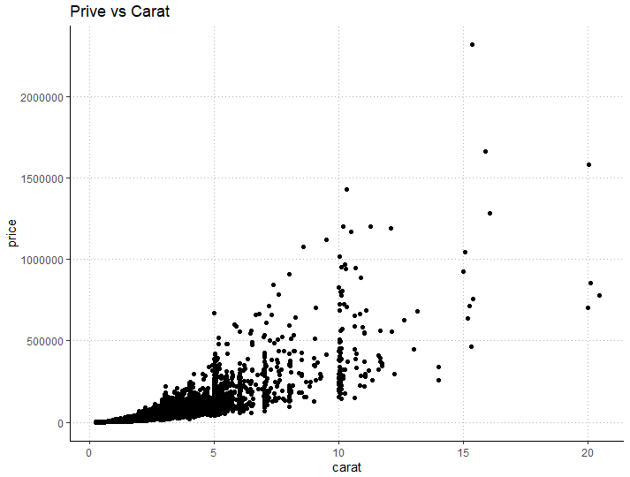
Scatterplot: price vs carat
 | Carat | Color | Clarity | Cut
R² | 0.5649 | 0.01207 | 0.0009451 | 0.001944
P-Value | 2.2e-16 | 2.2e-16 | 2.2e-16 | 2.2e-16
Price = β₀ + β₁Carat + ϵ
Notes:
According to marginal result table, price can be explained the most based on Carat comparing other variables. Therefore, we’ve decided to start the model with carat. And then we are going to add other variables by conducting F-test.

Slide 7
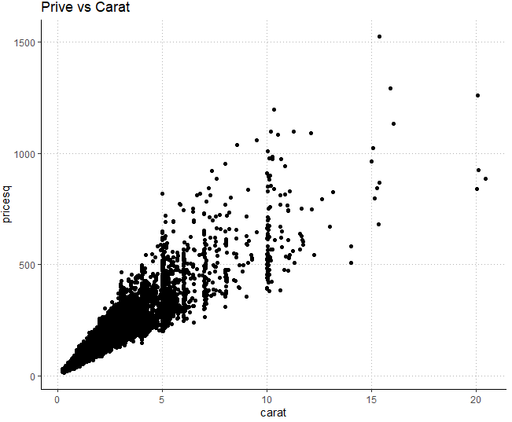
Transformation of Response Variable
√Price = β₀ + β₁Carat + ϵ
 | No transformation | Square root on Price
R² | 0.5649 | 0.9158

Slide 8
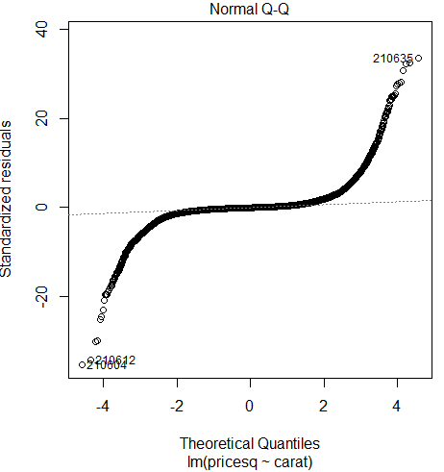
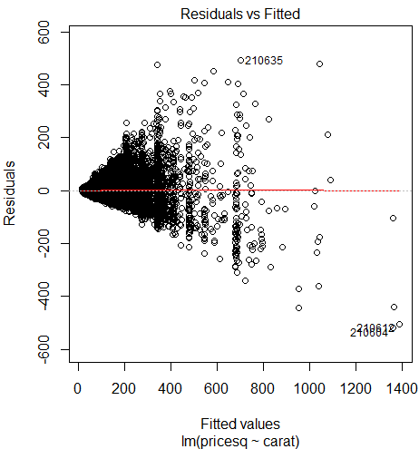
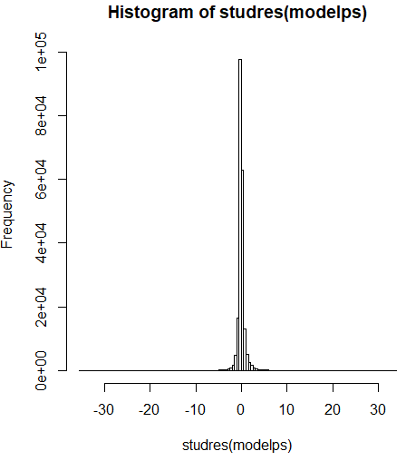
Assumption check for transformed model

Slide 9
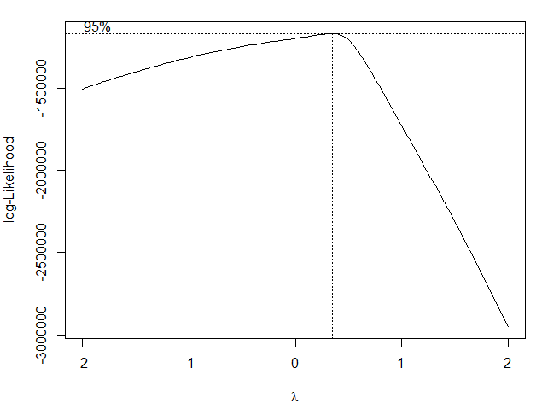
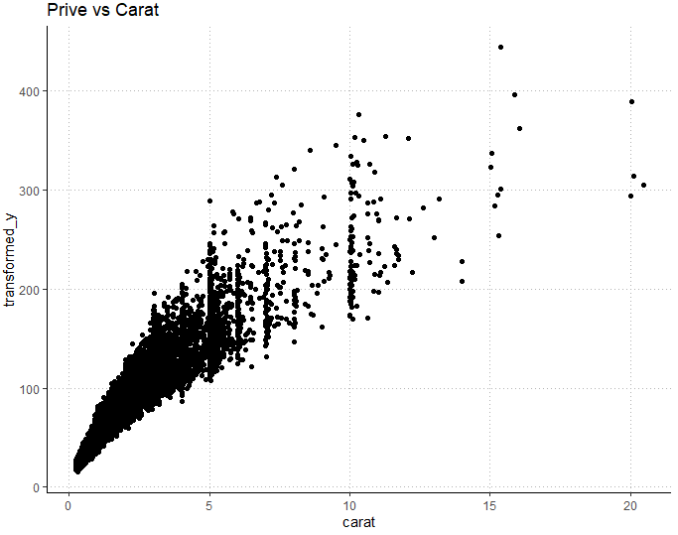
BoxCox Procedure
Lambda | R²
0.343434 | 0.897
Price^{λ} = β₀ + β₁Carat + ϵ
Notes:
In order to stabilize variance, we’ve conducted boxcox with best lambda = 0.66667. However, homoskedasticity is still violated.

Slide 10
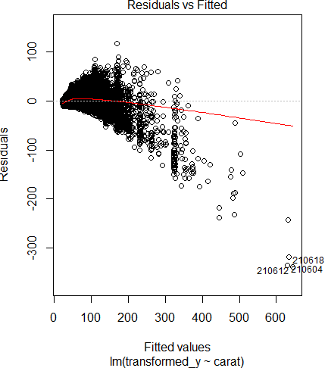
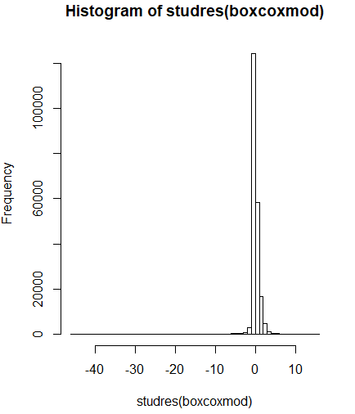
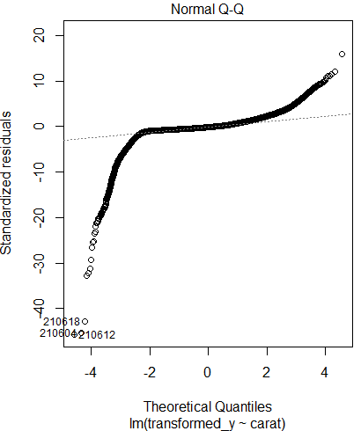
Assumption check after BoxCox Procedure

Slide 11
Variable Manipulation
Price → log(Price)
Carat → log(Carat)
log(Price) = β₀+ β₁log(carat)+ϵ
 | Before.trans | After.trans
R² | 0.5649 | 0.9501
Notes:
Based on the shape of the graph here, we’ve tried to put log both on dependent variable and predictor. Not only it show much better R^2, but also gave us better linearity and normality.

Slide 12
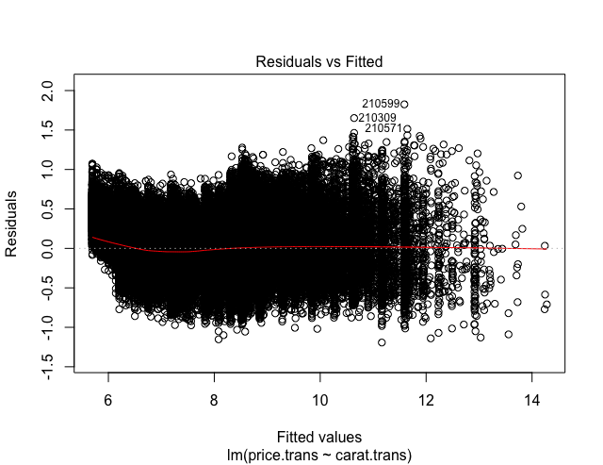
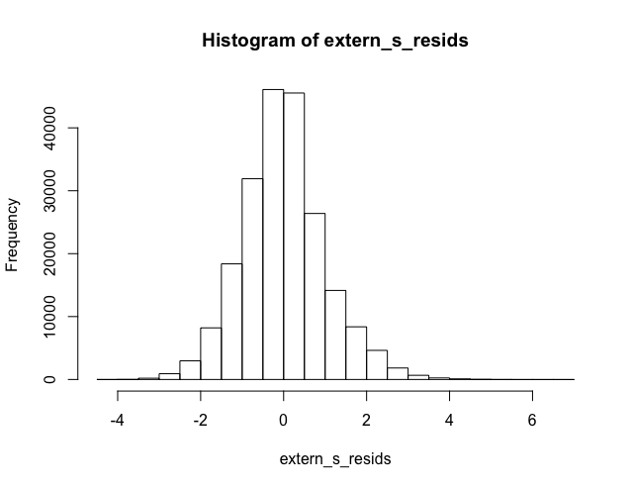
Assumption: Linearity, Homoskedasticity, Normality
Notes:
As you can see these two plot, it doesn’t have a pattern and linear relationship between price and carat. Therefore, we can say that it satisfies homoskedasticity and linearity assumption.

Slide 13
Partial F-test
Full Model : log(price) = β₀ + β₁log(carat) +β₂clarity +β₃color + β₄cut + ϵ
Reduced : log(price) = β₀ + β₁log(carat) + ϵ
H₀: β₂ = β₃ = β₄ = 0
H_{a} : At least one β_{j} ≠ 0
P-value
< 2.2e-16
Notes:
In order to see if other variables contribute to the price prediction, we’ve conducted partial F test. Reduce model is what we just tested, and full model is containing all variables from the dataset. For this test, the null hypothesis is the coefficient of clarity, color and but are all zero, and the alternative hypothesis is that at least one of those coefficient is differ from zero. With p value less than 0.05, we rejected the null hypothesis, therefore, we’ve selected full model as our final model

Slide 14
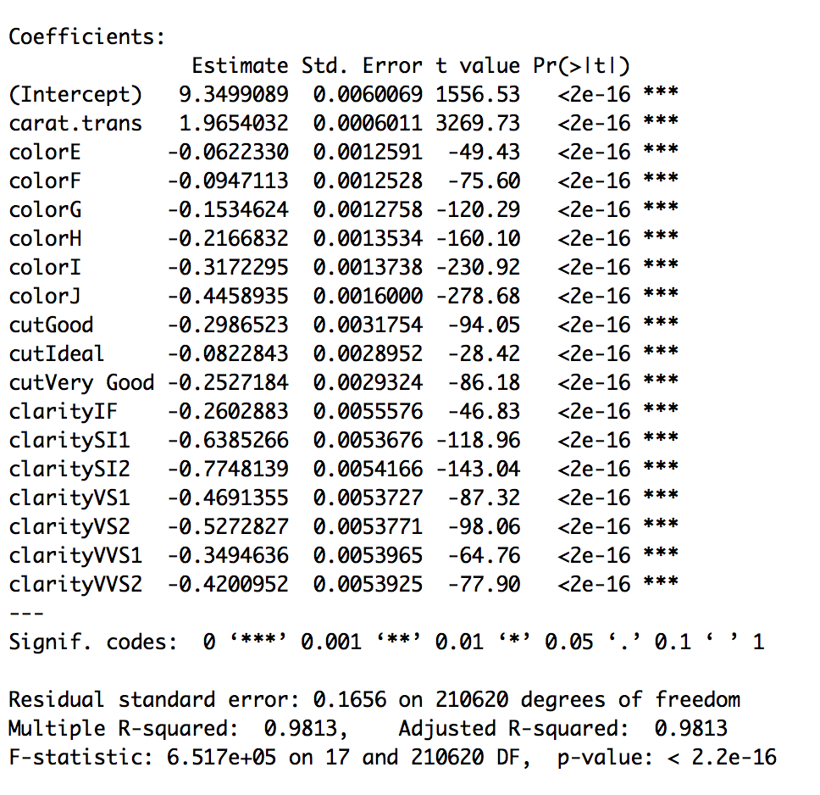
Summary of Final Model
Notes:
This is showing the summary of final model. As you can see, all variable are significant, and it also showed increased R-squared.

Slide 15
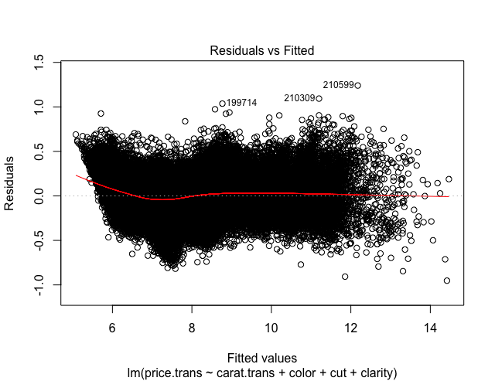
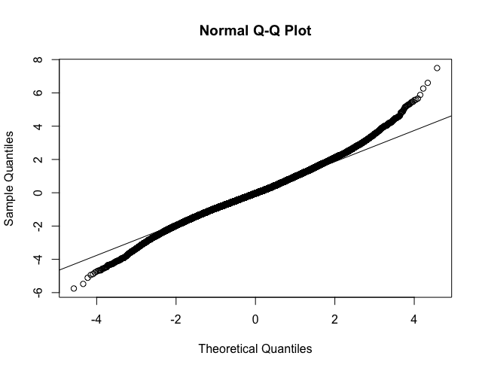
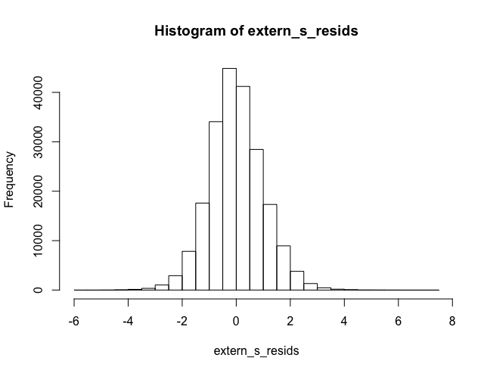
Assumption: Linearity, Homoskedasticity, Normality
Notes:
Finally, we’ve checked violation of linearity, homoskedasticity and normality assumption, and they all look satisfy the assumption.
# it has fanning out pattern so it does not satisfie homoskedasticity and linearity
# In other words, there does not exist equal variance along regression line, and
# linear relationship between variables

Slide 16
Conclusion - Model Interpretation
 | Estimate | Std. Error | t value | Pr(>|t|)
(Intercept) | 9.349909 | 0.006007 | 1556.527 | 0.00E+00
carat.log | 1.965403 | 0.000601 | 3269.727 | 0.00E+00
clarityIF | -0.26029 | 0.005558 | -46.8344 | 0.00E+00
claritySI1 | -0.63853 | 0.005368 | -118.959 | 0.00E+00
…
colorE | -0.06223 | 0.001259 | -49.4265 | 0.00E+00
colorF | -0.09471 | 0.001253 | -75.6022 | 0.00E+00
…
cutIdeal | -0.08228 | 0.002895 | -28.4208 | 2.43E-177
cutVery Good | -0.25272 | 0.002932 | -86.1804 | 0.00E+00
Notes:
This is the summary table of our final model. Let’s focus on the coefficient of carat.log because it is the most important predictor in the model.
What does the number 1.96 mean?

Slide 17
Conclusion - Model Interpretation
log y ~ βlog x
1% increase in x => β% increase in y (approx.)
β = 2
1% increase in carat => 2% increase in price
Notes:
When both x and y has log in front, the interpretation of beta becomes more intuitive, because we can think about it in terms of percentage.
(click)
In short, when x increases by 1%, y increase by beta%.
(click)
In this case, our beta is about 2.
(click)
Which means when carat increases by 1%, price increases by 2%.

Slide 18

Conclusion - Model Interpretation
2 * carat => 2^β * price = 4 * price
1 carat, $1000
2 carats, $4000
=
Notes:
Then we can also say this. Let me give you an example.
(click)
Let’s a diamond of one carat is worth a thousand dollars. How much should a diamond of 2 carats be?
(click)
So, if you have a diamond but want to get a new one with twice the size, you must give up three of your old diamond.

Slide 19
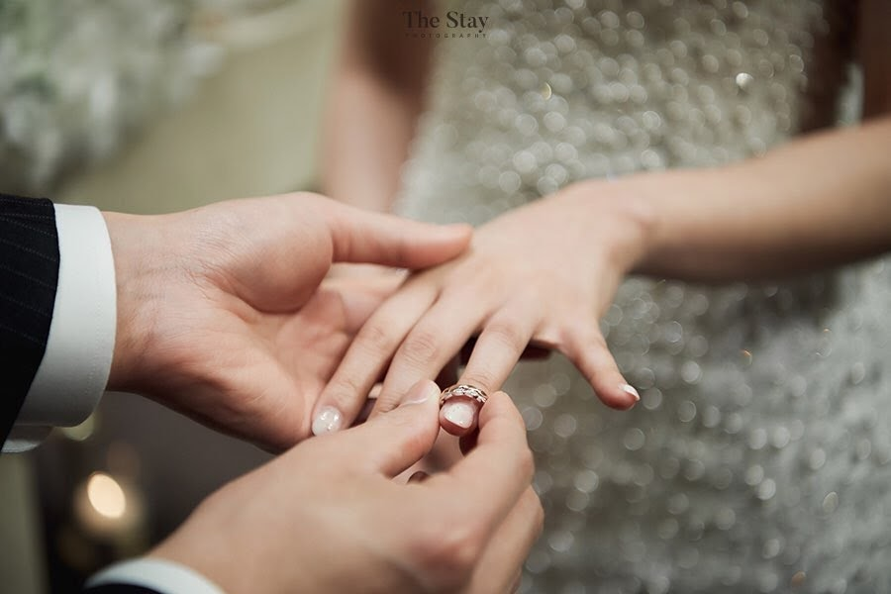

Slide 20
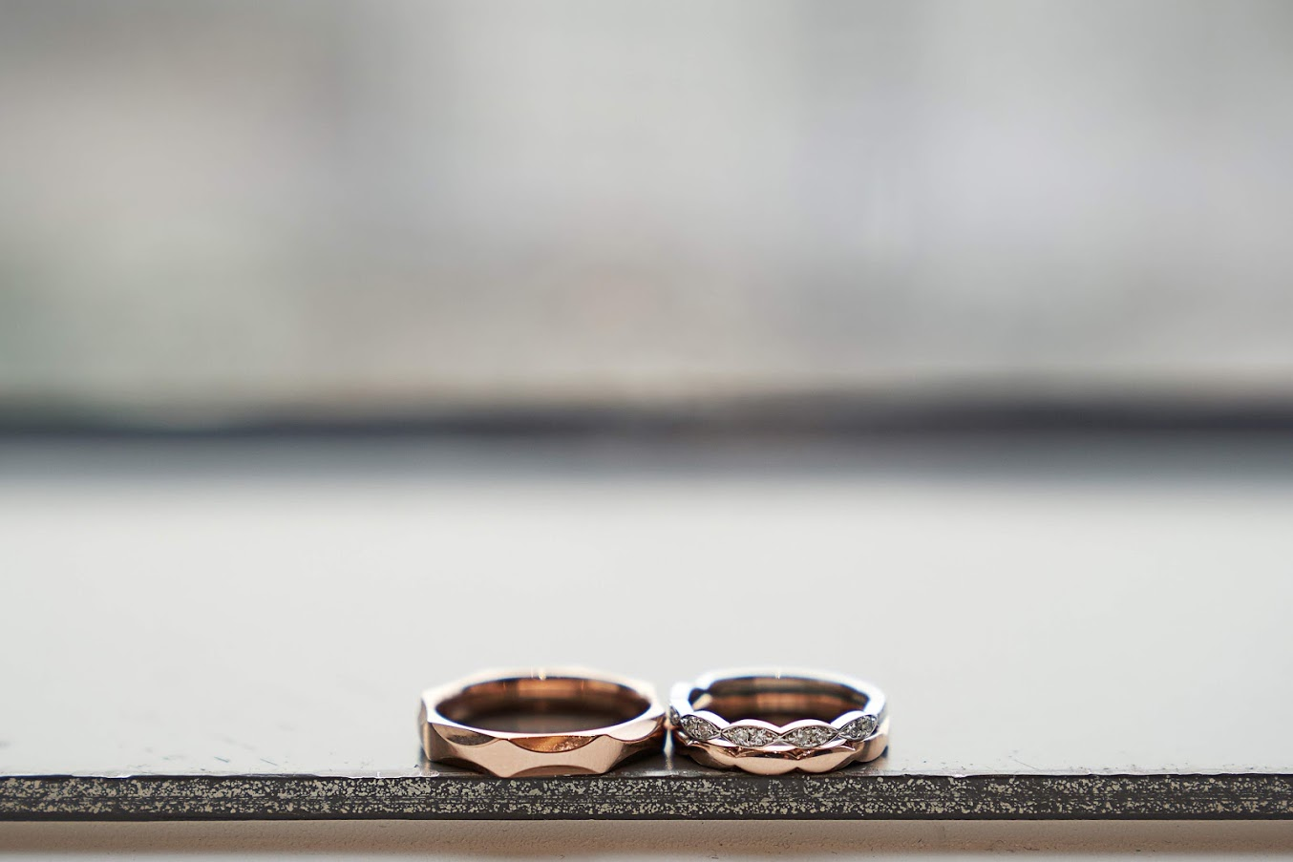

Slide 21
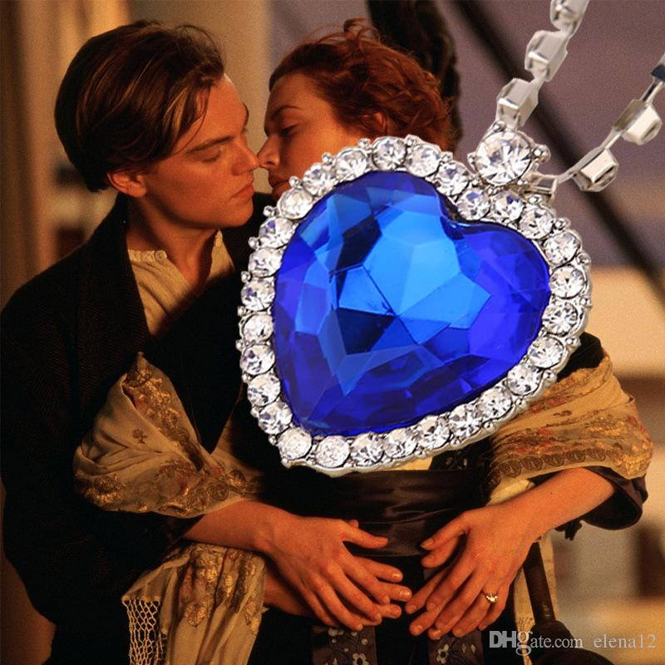
Conclusion - Predicting the price of diamonds
Heart of the Ocean specification:
Predicted price:
Carat | Clarity | Cut | Color
56 | FL | Ideal | D
$28,891,662
Notes:
Finally, let’s predict the price of the Titanic diamond. Any guess?
(click)
According to our model, it’s about $29 million. Pretty expensive.

Slide 22
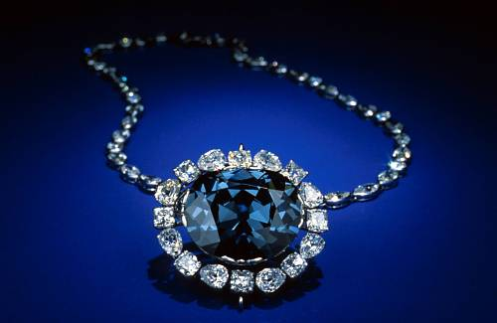
Conclusion - Predicting the price of diamonds
Hope diamond specification:
Predicted price:
Carat | Clarity | Cut | Color
45.5 | FL | Ideal | D
Real price(?):
$19,210,518
<<<
$250,000,000
Notes:
What about the real life version of Titanic diamond?
(click)
Our model predicts the price to be $19 million.
But how much is the real price of the diamond? Well, because it’s not for sale, there is no market price. But in 2009, it was reported insured for $250 million, which is more than 10 times higher than the predicted price.

Slide 23
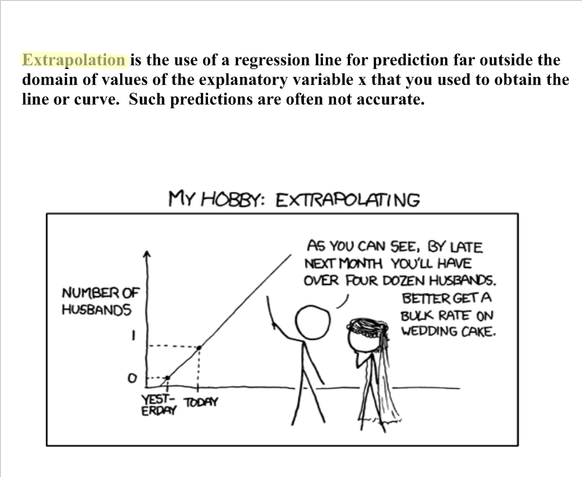
Conclusion - Limitation: Extrapolation
Notes:
Why are they so far from each other? One limitation to our prediction is that the diamonds are too big and far out of the range of our diamond dataset. This is called extrapolation and it may explain in part why our predicted price is so different from the real price.

Slide 24
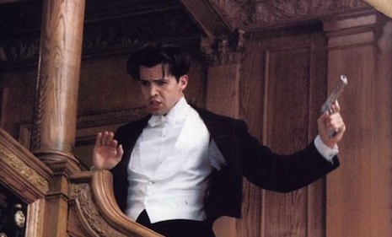
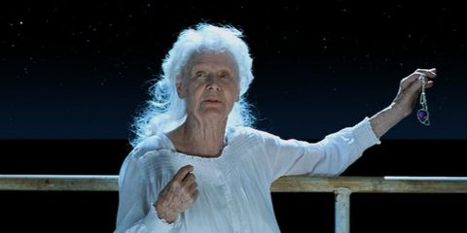
Conclusion
Notes:
What we can reasonably say about the titanic diamond is that it is at least worth $29 million, and Cal had all the rights in the world to get upset when Rose ran away with the diamond, and Rose must have been out of her mind when she threw the diamond into the ocean. Thanks.

Slide 25
Citation
https://www.flickr.com/photos/redlinx/2147861708
https://www.aliexpress.com/item/32629984459.htm
https://www.livescience.com/45239-hope-diamond-curse.html
https://www.quora.com/At-the-end-of-Titanic-why-does-Rose-throw-away-the-necklacel

Slide 26
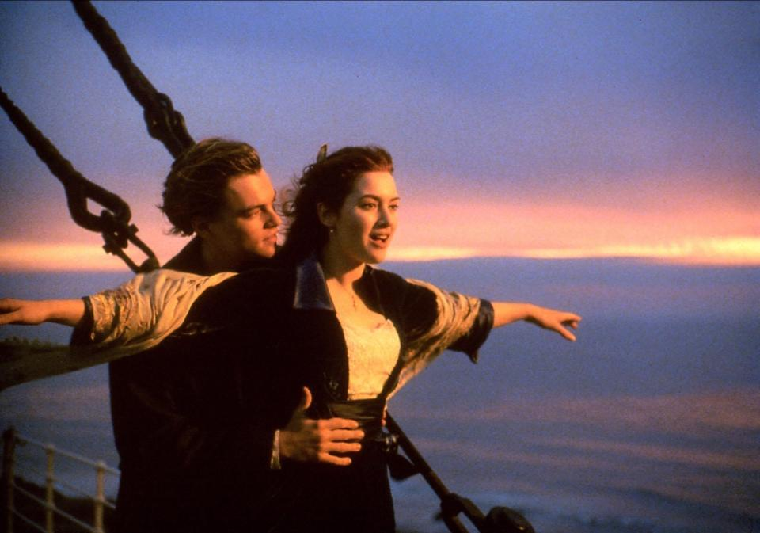
Thank you

Slide 27
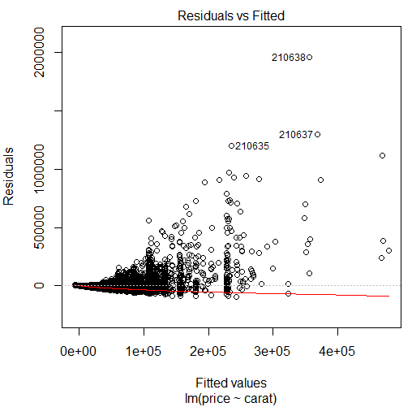
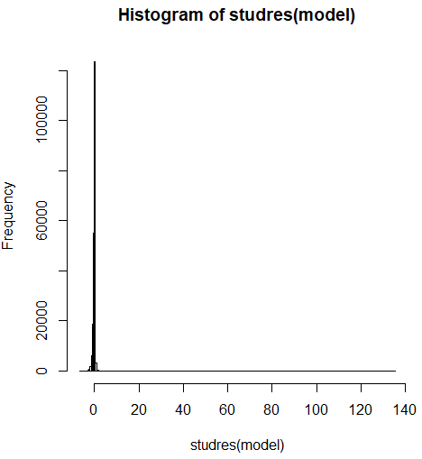
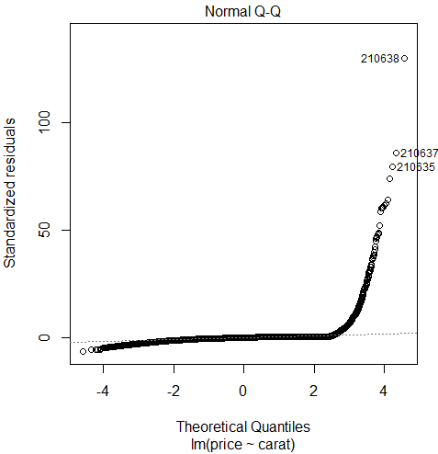
Assumption Check
Notes:
Then we checked whether the assumptions are met. The residual plot on the left shows that the linearity and constant variance assumptions are violated since the residuals have an upward fanning out pattern. The histogram and QQplot shows that the distribution is heavily skewed to the right, so the normality assumption is also violated.

